Slide 1
Academic Misconduct
Regional Rules Seminars 2015

Slide 2
Objectives
Provide background of academic misconduct legislative proposal.
Identify proposed changes to academic misconduct legislation.
Generate conversation and answer questions.
Seek feedback for NCAA Division I Committee on Academics.
Expected timeline.

Slide 3
Background
2011
Targeted review of academic misconduct legislation and regulatory structure.
April 2014
Official interpretation issued.
Recognition that academic misconduct legislation requires enhancement.
2014 - Now
Academic committees seek feedback on draft legislative concepts.

Slide 4
Who Have we talked to?
A wide cross-section of the membership has provided feedback, including:
NCAA Committees
Academic Cabinet.
Membership Groups
N4A.
FARA.
Committee on Academic Performance.
Committee on Academics.
Division I Council.
Committee on Infractions.
Student-Athlete Reinstatement.
SAAC.
Board of Directors.
DIA FARs.
CCACA.
COIA.
Conferences.
Practitioners.
Division II and III bodies as requested.

Slide 5
What did they have to say?
1983 last legislative update.
Media and Congressional attention.
Public trust in the NCAA as educational organization.
Interpretation rather than legislation.
Regulatory structure is confusing.

Slide 6
What did they have to say?
Legislation focuses too much on outcome.
Act/Actors/Outcome.
Institutional Policies and Procedures.

Slide 7
Establishment of “core Principles”
Membership feedback led to legislative priorities.
October 2014: NCAA Division I Committee on Academic Performance drafted principles.
January 2015: Committee on Academics refined core principles.
Proposed legislative draft directly correlates to membership-driven priorities.

Slide 8
Academic Misconduct Core Principles
Providing false or misleading APP information should be a violation.
Need spectrum of misconduct penalties.
Need to have and follow institutional academic misconduct policies and procedures.
Athletics shall be maintained as vital part of academic institution.
Institutional obligation to determine when misconduct occurs.
Involvement of institutional personnel should be a violation.
Misconduct between SA and student should be handled by institution.

Slide 9
NCAA Academic Integrity Issues
NCAA Academic
Integrity-Related Legislation
Institution’s Academic Misconduct Policies and Outcomes

Slide 10
Institutional Obligation
Institutions have the duty and obligation to determine when institutional academic misconduct occurs.
How does an institution determine whether academic misconduct occurred?
Apply its institutional policies applicable to all students.
Notes:
Most institutions have academic misconduct policies that outline and define what constitutes academic misconduct on their campus (e.g., cheating, plagiarism, providing fraudulent information, facilitating academic dishonesty).

Slide 11
Institutional Obligation
Why isn’t there a universal definition of what constitutes academic misconduct?
Individual campuses vary greatly.
Not NCAA’s place to regulate an institution’s academic programs or institutional academic policies.
Institutional policy incorporated into proposed legislation.

Slide 12
Proposed Legislative Changes

Slide 13
Key legislative Updates
Academic Misconduct.
Policies and Procedures.
Impermissible Academic Assistance vs. Extra Benefits.
NCAA Division I Academic Performance Program (APP).
Other Academic Improprieties.

Slide 14
Academic Integrity themes
Academic Misconduct
Other Academic Improprieties
APP
Impermissible Academic Assistance
Policies and Procedures

Slide 15
Academic Misconduct
When should institutions report academic misconduct to the NCAA?
Current State.
Fraudulent academic credit.
Academic misconduct.
Miscertification + competition.

Slide 16
Academic Misconduct
When should institutions report academic misconduct to the NCAA?
Proposed Future State.
When an alteration or falsification of a student-athlete's transcript or academic record occurs.
Academic misconduct leads to an “erroneous declaration of eligibility.”
An institutional staff member is involved regardless of the impact on eligibility.

Slide 17
Key Updates
Proposed legislation focuses on actors (institutional staff members) as opposed to outcome (Did the misconduct lead to eligibility and competition?).
Student-athlete academic misconduct violation threshold reduced to the misconduct resulting in student-athlete’s eligibility (i.e., student-athlete student needed to meet the six-hour rule). Competition no longer required.

Slide 18
academic integrity themes
Academic Misconduct
Other Academic Improprieties
APP
Impermissible Academic Assistance
Policies and Procedures

Slide 19
Policies And Procedures
Member institutions must have published institutional academic misconduct policies and procedures regarding academic misconduct.
May have policies that allow student-athletes more expeditious outcome than general students.
Policies must be approved by institution’s president.
May not have separate procedure for student-athletes (e.g., undue delay).

Slide 20
Academic Integrity themes
Academic Misconduct
Other Academic Improprieties
APP
Impermissible Academic Assistance
Policies and Procedures

Slide 21
Other Academic Improprieties
Pre-enrollment academic integrity issues.
Currently in Bylaw 10.1.
Relocating to Bylaw 14 for ease of reference.
Violations of this provision would continue to be very serious on the spectrum of penalties.
Intent is to consider pre-enrollment legislative changes in 2016-17 legislative cycle.

Slide 22
Academic Integrity themes
Academic Misconduct
Other Academic Improprieties
APP
Impermissible Academic Assistance
Policies and Procedures

Slide 23
Academic Performance Program
Providing false or misleading APP information should be a NCAA violation.
Example: Knowingly providing incorrect NCAA Division I Academic Progress Rate (APR) data in order to avoid postseason penalty.

Slide 24
Academic Integrity themes
Academic Misconduct
Other Academic Improprieties
APP
Policies and Procedures
Impermissible Academic Assistance

Slide 25
Impermissible Academic Assistance
Replaces the current extra benefits legislation. Relocates from Bylaw 16 to Bylaw 14. Specific to academic.
Drafted to target only egregious acts of assistance. For example, proofreading would not be impermissible assistance;
Notes:
Verbally Note:
When institutions make “absurd” decisions regarding academic assistance provided by staff members (e.g., taking online tests, writing papers, etc.).
Cited as violation when institutional policies may not be applicable.
The institution responsible for both its institutional process and adherence to NCAA legislation.

Slide 26
Impermissible Academic Assistance
What is it?
Substantial impermissible assistance by an institutional staff member or booster.
Academic assistance per Bylaw 16 still ok.
Academic exception for a student-athlete in order to improve a grade, earn credit or meet a graduation requirement.
If generally available to student-body, still ok.

Slide 27
Impermissible Academic Assistance
For impermissible academic assistance to be violated:
Institutional staff member or booster involved;
Institution does not find academic misconduct;
Substantial amount of assistance/exception;
Leads to eligibility of student-athlete;
Assistance/exception not generally available and/or not provided to all students; AND
Assistance not permitted in Bylaw 16.3.

Slide 28
Impermissible Academic Assistance – Exception Example
An English professor allowed a student-athlete to turn in a term paper two semesters after the course was completed for full credit.
The professor did not allow any other student in the course to receive the exception.
Institutional policy does not address this type of issue.

Slide 29
Impermissible Academic Assistance – Exception Example
The institution did not find academic misconduct per institutional policies and procedures.
The exception resulted in the student-athlete receiving a passing grade in the course and directly impacted the student-athlete’s certification of eligibility.
Would this be considered an NCAA violation under "impermissible academic assistance"?

Slide 30
Impermissible Academic Assistance – Exception Example
Yes.
The academic exception was not generally available to the institution’s student body or students in the involved course.
Academic misconduct was not found by the institution and an institutional staff member was involved.
The exception led to an erroneous certification of eligibility of the student-athlete.

Slide 31
Impermissible Academic Assistance – Assistance Example
A booster arranged for a student employee in the dining hall to complete a term paper for a student-athlete, who was in his fourth year of enrollment.
The paper was submitted to the professor and the student-athlete received a passing grade in the course, which subsequently kept the student-athlete eligible for competition.
After exhausting eligibility, the student-athlete withdrew from the institution.

Slide 32
Impermissible Academic Assistance – Assistance Example
The institution investigated the issue, but did not find academic misconduct, citing the student-athlete's withdrawal from the institution.
Would this situation be considered an "impermissible academic assistance" violation?

Slide 33
Impermissible Academic Assistance – Assistance Example
Yes.
The institution determined that academic misconduct did not occur.
The academic assistance provided was not generally available to the institution’s student body or students in the involved course.
The assistance was substantial and not permitted in Bylaw 16.3.

Slide 34
Impermissible Academic Assistance – Assistance Example
A booster and an institutional staff member were involved (due to the student working at the direction of a booster).
The assistance led to an erroneous certification of eligibility of the student-athlete.

Slide 35
For further Refinement
Definition of institutional staff member.
Should it be as broad as the Bylaw 10.1 definition?
Should student employees be included?
Should student employees who primarily work in athletics be included?

Slide 36
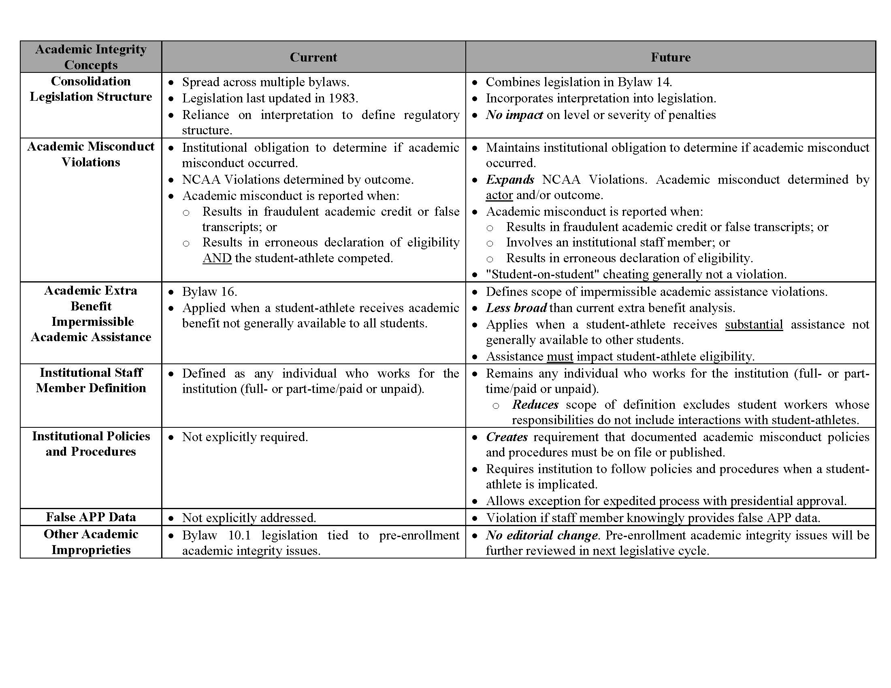

Slide 37
Future
NCAA Division I Committee on Infractions Subcommittee and group of Committee on Academics members refining final draft.
Committee on Academics anticipates recommending legislation in June 2015.
If adopted by the membership in April 2016, legislation could be effective as soon as August 2016.

Slide 38
QUESTIONS?

