Slide 1
Legislative Relief Waivers
Kelly Brummett
Ryan allen Hall

Slide 2
legislative relief waivers
Established to provide flexibility with regard to NCAA legislation.
No other specified staff or committee.
Proactive waivers, requesting relief before a circumstance/event occurs.
Cannot waive violations.
Approximately 1,600 legislative relief waivers filed in 2014 (Divisions I, II and III combined).

Slide 3
What is not a legislative relief waiver?
Full-time enrollment.
Hardship waivers.
Season-of-competition waivers.
Initial-eligibility waivers.
2-4 and 4-2-4 transfer waivers.
Progress-toward-degree waivers.
Extension of five-year clock.*

Slide 4
Is a legislative relief waiver necessary?
What specific legislation/interpretation is prohibiting the circumstances desired within the waiver?
Within that legislation, is there a designated group with waiver authority?
Previously approved waivers.
Incidental expenses waivers.

Slide 5
What should be submitted?
Completed NCAA Division I Committee for Legislative Relief (CLR) waiver submission via RSRO.
Buckley Statement.
Complete set of facts/chronology.
Legible official transcripts.
Supporting documentation.
Prohibitive bylaw cites.
CLR case precedent.

Slide 6
analysis
Extenuating or extraordinary circumstances.
Student-athlete (SA) well-being.
Intent of the legislation.
Recruiting/competitive advantage.
Guidelines.
CLR case precedent.

Slide 7
Interpretations philosophy
Goal is increased decision making and more shared responsibility.
Increase institutional autonomy.
Examine and reduce rules that are inconsequential and/or difficult to enforce.
Increase SA success.
Interps philosophy used on the "front end."

Slide 8
Temporary review process
NCAA Division I Leadership Council granted staff authority to consider extenuating circumstances and exercise reasonable discretion.
Similar to interpretations philosophy but applies flexibility to waiver outcomes.

Slide 9
Temporary review process
Applies to waivers involving:
Health and safety of a SA;
Penalty would likely have a significant negative impact on SA well-being;
Prospective or enrolled SA who has served active duty in military or delayed enrollment due to religious mission(s);
Potential significant withholding or application of the penalty is disproportionate or otherwise inconsistent with the intent of the legislation; and
Nominal or inconsequential benefits to SAs.

Slide 10
4-4 transfer
No longer seeking a waiver for immediate eligibility.
Potential sixth year on clock.
Extension analysis similar to current analysis for immediate eligibility.
Must have mitigation for transfer.

Slide 11
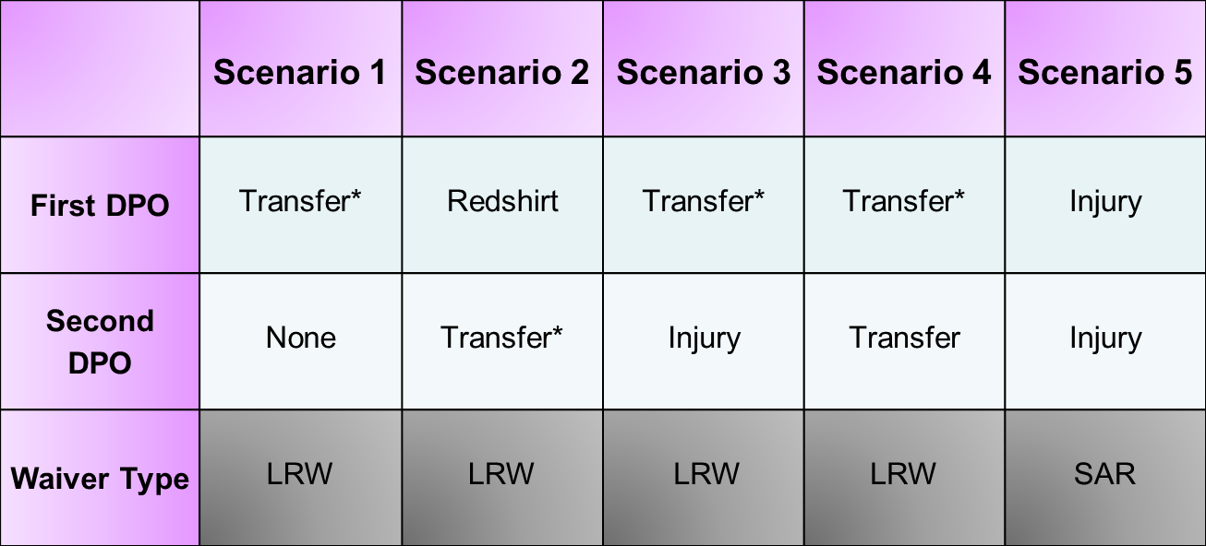
4-4 transfer
*Must have mitigation for the transfer.

Slide 12
Urgent waivers and phone waivers
For unforeseen events or circumstances.
Institutions may call 317/917-6144 and indicate they have a potential CLR phone waiver request.
Phone waivers do not eliminate the need to submit a waiver.

Slide 13
Best practices
Search CLR case precedent on LSDBi and RSRO.
See CLR website to view tips for searching precedent. www.ncaa.org/compliance/waivers/legislative-relief-waivers
Call 317/917-6144 to contact legislative relief staff about a pending waiver.
File waiver at the time it is discovered that a waiver is necessary.

Slide 14
Case study no. 1 - facts
Zack is scheduled to make an official visit to Bayside University on Friday.
Thursday, Zack notified Bayside that his mother can no longer take time off from work to attend the visit with him.
Instead, Zack would like to bring his Uncle Richard.
Bayside would like to treat Uncle Richard like a permissible family member for the official visit.

Slide 15
Case study No. 1 – Assertions
Zack's father has never been a part of his life.
Uncle Richard has been the only father-figure in Zack's life that he has ever known.
Zack's mother will not be able to attend any official visits and Uncle Richard will likely attend any future visits as well.

Slide 16
Case study NO. 1 - OUTCOME
Granted.
Staff noted that Zack's mother is unable to attend the current visit and will not attend any future visits.
Additionally staff noted that Zack's Uncle Richard has been a father-figure his whole life and will attend future visits as well.

Slide 17
Case study no. 2 - Facts and assertions
A.C. is a phenomenal baker.
Initially, A.C. baked only for family and friends but in 2011, he decided to start his own bakery.
2013-14 academic year: A.C. enrolled at Bayside.
In December 2014, A.C. won several awards for best tasting and best decorated cake.
As a result, Bayside would now like A.C. to be able to promote his baking business. May he do so?

Slide 18
Case study no. 2 - Outcome
Interpretive Flexibility?
No.
The legislation is clear and A.C. may not use his name, image, or likeness to promote a commercial product.

Slide 19
Case study no. 2 - outcome
CLR Waiver?
Granted.
Conditions:
No reference to A.C.'s involvement in athletics;
Bayside may not be involved in any way; and
Compensation is at a commensurate rate.

Slide 20
Case study no. 3 - facts
May 2012: Kelly graduated from high school.
2012-13: Kelly's one-year grace period.
March 2013: Kelly went on a two-year church mission and returned in March 2015.
April 2 and April 9, 2015: Kelly played in what she believed to be pick up soccer games with her high school friends.
Summer 2015: Kelly will enroll at Bayside.

Slide 21
Case study no. 3 - assertions
Kelly was required by her church to serve a two-year church mission prior to turning 20-years old.
Kelly had no idea playing pick-up soccer matches with some friends would cost her a season of eligibility.
Kelly said she played in the games just to get "a little exercise."
No one at Bayside ever informed Kelly that she should not compete after returning from her mission.

Slide 22
Case study no. 3
NCAA Eligibility Center (EC) Certification: Kelly is charged one season of competition and must serve an academic year of residence.
Bayside requests that Kelly be immediately eligible and retain four seasons of competition.
What happens next?

Slide 23
Case study NO. 3
If compelling mitigation exists, then Bayside may submit a CLR waiver to seek full relief.
Compelling mitigation may include:
Facts and assertions outside the scope of the legislation;
Low level/noncompetitive competition;
Chronology of events;
Whether Kelly enrolled after first opportunity after delay period;
Whether Kelly was misadvised; and
Kelly already served a significant penalty.

Slide 24
Case Study No.3 - outcome
Starting Point: One-for-one withholding (two contests) based on EC certification.
If the number of contests/dates of competition is less than or equal to 50% of the NCAA Bylaw 17 maximum limitations, the starting point is a 1-for-1 withholding.
CLR Relief?
Via CLR waiver relief: Kelly received full relief and was not required to serve an academic year in residence nor required to sit two contests.

Slide 25
Case study No. 4 - Facts
March-June 1998: Lisa's mother was treated for depressive and anxiety disorder.
2005-06 academic year: Lisa completed grade nine.
2006-07 academic year: Lisa completed grade 10.
2007-08 academic year: Lisa failed grade 11.
April-July 2008: Lisa's mother was treated for back spasms.
2008-09 academic year: Lisa completed grade 11.

Slide 26
Case study no. 4 - facts
June 2009: Lisa's expected date of high school graduation.
July 2009: Lisa 's mother was treated for severe adaptive disorder with mixed swings of emotions.
2009-10 academic year: Lisa failed grade 12.
2010-11 academic year: Lisa completed grade 12. Lisa competed in 25 basketball contests.
2011-12 academic year: Lisa competed in 25 basketball contests.

Slide 27
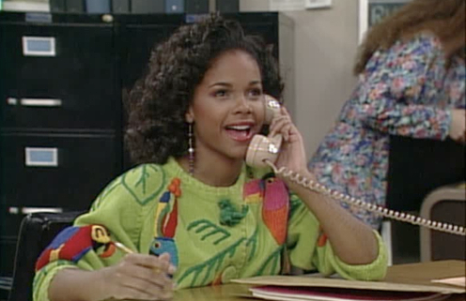
Case study no. 4
EC Certification: Lisa used two seasons of competition and must serve an academic year of residence.
Bayside would like Lisa to retain four seasons of competition and be immediately eligible for competition.

Slide 28
Case study no. 4 - outcome
Using Temporary Review Process (TRP), staff provided flexibility.
Lisa must be withheld from the first 50% of the maximum limitations in women's basketball.
SA well-being:
Chronology of events supports the necessity for Lisa to delay enrollment;
Lisa was required to provide care-giving responsibilities; and
Lisa enrolled at the first opportunity after her mother's mental health improved.

Slide 29
Case study no. 5 - facts
February 2014: Screech signed a National Letter of Intent (NLI).
Summer 2014: Screech received athletics aid for summer classes.
July 8, 2014: Screech suffered a back injury and can no longer participate in athletics.
Bayside would like to provide Max, a walk-on SA, with the athletics aid Screech would have received.

Slide 30
Case study no. 5 - assertions
Screech participated in only a minimal amount of summer conditioning; and
Screech was medically disqualified from participating in athletics.

Slide 31
Case study no. 5 - outcome
Using TRP, staff provided flexibility.
SA well-being:
Screech is medically disqualified moving forward;
No competitive advantage gained to award athletics aid to Max, a walk-on SA; and
Minimal amount of participation by Screech during summer 2014.

Slide 32
Case study no. 6 - facts
November 13, 2014: Jessie signed a NLI for the 2015-16 academic year.
December 13, 2014, and February 28, 2015: Jessie dislocated her shoulder on two separate occasions during high school basketball competition.
March 10, 2015: Jessie was diagnosed with a labral tear in her left shoulder. Jessie 's physician recommended surgery to repair her shoulder.
March 16, 2015: Jessie was admitted to Bayside.

Slide 33
Case study no. 6 - Assertions
2015 summer term: Jessie plans to enroll at Bayside.
Jessie 's recovery from surgery will take approximately six-to-nine months of intense physical therapy.
Jessie 's medical insurance does not cover the medical and rehabilitation services provided by Bayside's physician.

Slide 34
Case study no. 6 - outcome
Using TRP, staff provided relief to allow Bayside to pay for Jessie's medical expenses prior to her enrollment.
Jessie signed a NLI and has been admitted to Bayside;
Jessie 's injury occurred after she signed the NLI; and
Jessie 's family is unable to afford her surgery.

Slide 35
Case study no. 7 - Facts
Violet's mother is unable to work due to multiple, ongoing health conditions.
Violet's father is the primary source of income for the family. However, Violet's father was recently incarcerated.
Bayside would like to "provide" for Violet's family.
Permissible?

Slide 36
Case study no. 7 - assertions
Violet's mother and four younger siblings temporarily live in a housing shelter.
Bayside would conduct a permissible fundraiser for Violet and her family to help provide funds.
Specifically, Bayside would like to provide Violet's family with rent and miscellaneous expenses.

Slide 37
Case Study No. 7 - outcome
Using TRP, staff granted flexibility.
Conditions:
Bayside may provide reasonable actual and necessary expenses for a limited time period until Violet's family receives proceeds from the fundraiser;
Proceeds must be designated for a specific purpose;
Receipts must be kept on file by institution; and
Bayside may not engage in recruiting activities with Violet's siblings or other family members.

