Slide 1
Myths and Realities about Academic Issues in Division I June 2015 NCAA Regional Rules Seminar – Denver Shauna Cobb Azure Davey Tom Paskus

Slide 2
The best way to enhance student-athlete graduation rates is to go back to a cut-score on the ACT/SAT

Slide 3
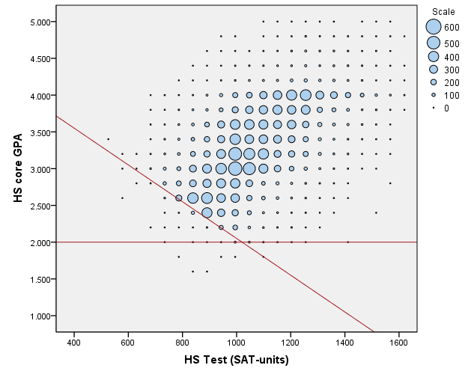
Division I Sliding Scale w/ 2.00 Minimum (2003 to 2016)
Note: SAs are currently eligible for aid and competition if in the upper right quadrant (HSCGPA > 2.00 and above sliding scale).

Slide 4
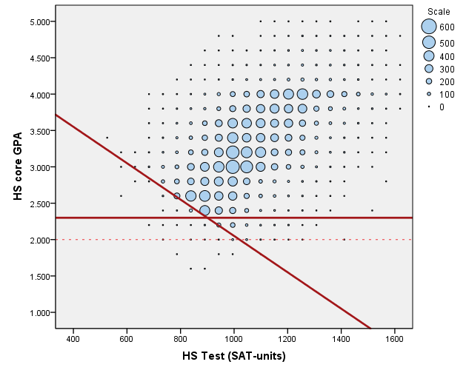
Current Sliding Scale with a HSCGPA Floor=2.30
% Current SAs Below | 2.4%
% Minority / White SAs Below | 4.3% 1.4%
% MBB / MFB Below | 8.4% 5.2%
Relative weight of HSCGPA v. TEST | 3.9

Slide 5
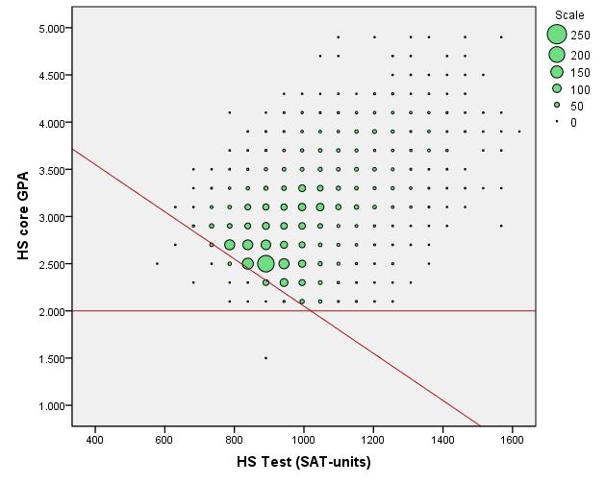
Current IE Rule (Football)

Slide 6
First-year ineligibility would provide a substantial academic benefit

Slide 7
First-Year Academic Outcomes in Football as a Function of Redshirting
Outcome | Competed | Redshirted | Impact of Redshirting after Statistically Controlling for HSCGPA, TEST
First Semester Credits | 12.9 | 11.1 | -1.6*
Year-End Credits | 28.4 | 26.7 | -1.6*
First Semester GPA | 2.52 | 2.60 | +0.12*
Year-End GPA | 2.66 | 2.67 | +0.06*
Note: Data from 2012-13 frosh. Redshirting statistically significant at p<.01 in linear regression after
controlling for HS core grades and ACT/SAT score = *

Slide 8
First-Year Redshirting by Sport in Division I (2014 Data)
Men | Redshirt %
Football (FBS) | 58%
Football (FCS) | 50%
Wrestling | 49%
Volleyball | 26%
Cross Country | 22%
Track (Indoor) | 19%
Track (Outdoor) | 19%
Baseball | 16%
Gymnastics | 15%
Soccer | 14%
Basketball | 14%
Golf | 14%
Lacrosse | 12%
Water Polo | 11%
Skiing | 6%
Swimming | 3%
Tennis | 3%
Ice Hockey | 2%
Rifle (co-ed) | 0%
Fencing | 0%
Women | Redshirt %
Cross Country | 19%
Track (Indoor) | 17%
Track (Outdoor) | 16%
Soccer | 13%
Gymnastics | 11%
Volleyball | 11%
Basketball | 10%
Field Hockey | 10%
Skiing | 10%
Water Polo | 10%
Rowing | 9%
Softball | 6%
Lacrosse | 6%
Golf | 5%
Bowling | 5%
Ice Hockey | 5%
Tennis | 3%
Swimming | 3%
Fencing | 2%

Slide 9
“Major clustering” is on the rise because of new IE, PTD and APR standards

Slide 10
How to define “major clustering”?
Case, Greer & Brown (1987) – Clustering = 25% or more of student-athletes on a team with the same major.
This definition lacks sufficient nuance.

Slide 11
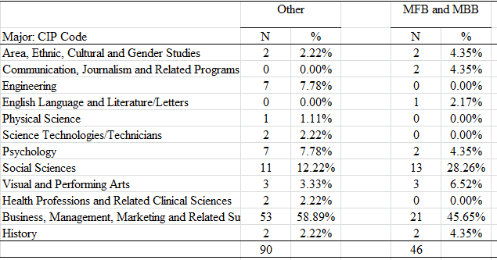
Majors of MFB/MBB vs. Other Male SAs
(Division I School – No Statistically Significant Difference)

Slide 12
Majors in Division I Football
Football Student-Athletes |  |  |  |  |  |  |  |  |  |  | Overall Male National N=734,133
Major Category | Academic Year |  |  |  |  |  |  |  |  |  | Academic Year
 | 2003-04 N=9,728 | 2004-05 N=9,603 | 2005-06 N=9,664 | 2006-07 N=9,610 | 2007-08 N=9,642 | 2008-09 N=9,732 | 2009-10 N=9,773 | 2010-11 N=9,833 | 2011-12 N=9,904 |  | 2010-11
Social Sciences | 24.6 | 25.4 | 23.7 | 24.3 | 25.1 | 24.7 | 24.7 | 24.5 | 26.1 |  | 16.4
Business, Management, Marketing and Related | 20.4 | 18.9 | 18.3 | 18.7 | 19.1 | 19.0 | 18.9 | 18.6 | 17.3 |  | 25.5
Liberal Arts & Sciences, General Studies and Humanities | 11.1 | 11.7 | 12.4 | 12.3 | 12.2 | 11.9 | 11.9 | 13.0 | 12.0 |  | 14.4
Communication, Journalism and Related | 8.1 | 8.2 | 8.5 | 8.5 | 8.5 | 8.8 | 8.9 | 8.5 | 7.9 |  | 9.3
Parks, Recreation, Leisure and Fitness | 7.3 | 8.1 | 8.4 | 8.4 | 8.2 | 8.1 | 8.5 | 8.0 | 6.7 |  | 2.6
Education | 8.3 | 8.1 | 7.8 | 7.1 | 6.5 | 6.4 | 5.8 | 5.7 | 6.6 |  | 2.9
Multi/Interdisciplinary Studies | 4.2 | 3.9 | 5.1 | 5.5 | 5.6 | 6.3 | 6.1 | 6.1 | 6.4 |  | 2.8
Engineering and Engineering Technology | 6.0 | 5.6 | 5.4 | 4.9 | 5.3 | 5.2 | 5.3 | 5.3 | 5.4 |  | 12.6
Biological & Biomedical Studies | 3.3 | 3.6 | 3.6 | 3.8 | 3.6 | 3.6 | 3.6 | 3.6 | 3.5 |  | 7.0
Psychology | 2.6 | 2.7 | 2.8 | 2.6 | 2.5 | 2.6 | 3.2 | 3.3 | 3.3 |  | 3.2
Health Professions and Related Clinical Services | 1.9 | 1.6 | 1.5 | 1.6 | 1.8 | 1.6 | 1.6 | 1.6 | 1.8 |  | 2.9
Area, Ethnic, Cultural and Gender Studies | 1.0 | 1.5 | 1.4 | 1.4 | 1.1 | 1.1 | 1.0 | 1.1 | 0.8 |  | 0.4
Notes:
Juniors and seniors, undergrad only. Sorted by 2011-12 SAs.

Slide 13
Division I Student-Athlete Self-Report of Issues with Major Choice
If you weren’t a college athlete, would you still choose your current major?
 | Baseball | Men’s Basketball | Football |  | All Other Men’s Sports | Women’s Basketball | All Other Women’s Sports
Probably / Definitely Not | 16% | 15% | 16% | 10% | 7% | 9% | 7%
Has athletics participation prevented you from majoring in what you really want?
 | Baseball | Men’s Basketball | Football |  | All Other Men’s Sports | Women’s Basketball | All Other Women’s Sports
Yes, but no regrets | 24% | 18% | 20% | 13% | 11% | 18% | 13%
Yes and I regret | 5% | 6% | 12% | 5% | 5% | 7% | 6%
Source: NCAA GOALS-10 study. Responses among those who have selected a major.

Slide 14
Having additional money is the biggest concern among NCAA student-athletes

Slide 15
If you could change one thing about your SA experience…

Slide 16
Average Hours Spent Per Week In-Season on Athletic Activities (2010 SA Self-Report)
Division I
 | Baseball | Men’s Basketball | Football (FBS/FCS) |  | All Other Men’s Sports | Women’s Basketball | All Other Women’s Sports
Athletic Hrs | 42.1 | 39.2 | 43.3 | 41.6 | 32.0 | 37.6 | 33.3
Division II
Athletic Hrs | 39.0 | 37.7 | 37.5 |  | 31.3 | 34.2 | 31.7
Division III
Athletic Hrs | 34.8 | 30.8 | 33.1 |  | 29.2 | 29.8 | 28.9
Note: Green = Decrease of 2+ hours on athletics from 2006;
Red = Increase of 2+ hours on athletics from 2006

Slide 17
Average Sum of Hours Spent Per Week In-Season on Academic Activities and Athletic Activities (2010 SA Self-Report)
Division I
 | Baseball | Men’s Basketball | Football (FBS/FCS) |  | All Other Men’s Sports | Women’s Basketball | All Other Women’s Sports
Ave. Sum | 73.7 | 76.5 | 81.3 | 79.8 | 68.0 | 76.5 | 73.4
Division II
Ave. Sum | 71.8 | 73.5 | 74.2 |  | 67.6 | 71.6 | 73.1
Division III
Ave. Sum | 70.4 | 65.6 | 71.0 |  | 68.8 | 71.1 | 72.0
Note: Green = 2+ hours less on academics/athletic sum vs. 2006;
Red = 2+ hours more on academics/athletic sum vs. 2006.

Slide 18
In-Season Time Demands – Men (Self-report from GOALS study, 2010)
Academic Hours / Week
Division I | Division II | Division III
41 | 39 | 42
38 | 39 | 41
37 | 38 | 40
37 | 38 | 40
37 | 37 | 39
36 | 36 | 38
36 | 36 | 38
33 | 36 | 38
32 | 33 | 36
31 | 31 | 35
31 |  | 34
Athletic Hours / Week
Division I | Division II | Division III
42 | 40 | 35
42 | 39 | 35
39 | 38 | 35
36 | 37 | 33
35 | 35 | 33
32 | 34 | 31
32 | 30 | 29
32 | 29 | 28
31 | 29 | 27
31 | 28 | 27
30 |  | 26

Slide 19
In-Season Time Demands – Women (Self-report from GOALS study, 2010)
Academic Hours / Week
Division I | Division II | Division III
42 | 45 | 46
41 | 44 | 44
41 | 43 | 44
41 | 42 | 44
41 | 41 | 44
40 | 40 | 43
40 | 39 | 43
40 | 37 | 43
39 | 37 | 43
38 |  | 41
38 |  | 41
38
Athletic Hours / Week
Division I | Division II | Division III
38 | 37 | 33
36 | 34 | 30
36 | 32 | 30
36 | 31 | 29
34 | 31 | 29
34 | 31 | 28
32 | 30 | 28
32 | 29 | 28
31 | 27 | 27
31 |  | 27
30 |  | 25
29

Slide 20
Percentage of SAs Reporting As Much or More Time on Athletic Activities in Off-Season than In-Season (2010 SA Self-Report)
Division I
 | Baseball | Men’s Basketball | Football (FBS/FCS) |  | All Other Men’s Sports | Women’s Basketball | All Other Women’s Sports
% same/more | 77% | 69% | 70% | 70% | 61% | 46% | 57%
Division II
% same/more | 79% | 68% | 70% |  | 63% | 54% | 55%
Division III
% same/more | 55% | 59% | 62% |  | 46% | 38% | 34%

Slide 21
Most student-athletes only care about being athletes

Slide 22
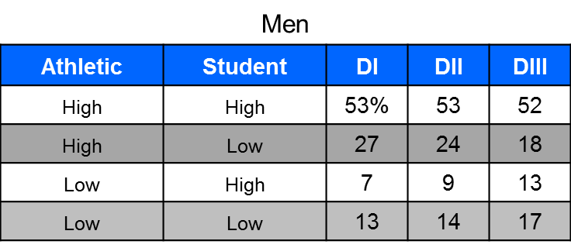
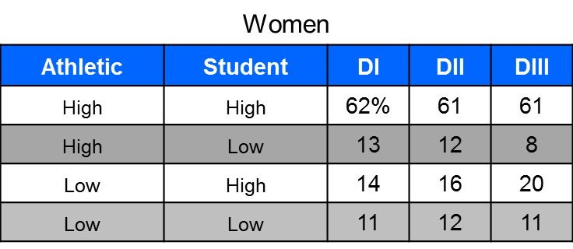
Student-Athlete Identity (GOALS 2010 -- % Reporting ‘Very High’ Levels)

Slide 23
High Athletic Identity (GOALS 2010, Collapsed across NCAA division)
Men | %
Ice Hockey | 86
Baseball | 80
Football | 77
Wrestling | 77
Track | 75
Soccer | 74
Basketball | 74
Swimming | 72
Golf | 70
Lacrosse | 69
Tennis | 62
Women | %
Gymnastics | 88
Rowing | 83
Lacrosse | 78
Volleyball | 76
Softball | 76
Field Hockey | 75
Swimming | 74
Soccer | 71
Basketball | 69
Golf | 68
Track | 68
Tennis | 61

Slide 24
High Academic Identity (GOALS 2010, Collapsed across NCAA division)
Men | %
Swimming | 69
Track | 67
Tennis | 65
Football | 65
Wrestling | 64
Ice Hockey | 64
Soccer | 63
Basketball | 61
Golf | 58
Lacrosse | 57
Baseball | 55
Women | %
Gymnastics | 84
Swimming | 82
Volleyball | 82
Field Hockey | 82
Rowing | 81
Lacrosse | 80
Track | 79
Tennis | 79
Soccer | 78
Softball | 76
Golf | 75
Basketball | 71

Slide 25
Student-Athlete Perceptions of How They Are Viewed by Faculty
% Agree / Strongly Agree with the following… | Men |  |  | Women
 | D1 | D2 | D3 | D1 | D2 | D3
Professors on this campus assume I’m not a good student because I’m also an athlete. | 20% | 18% | 14% | 13% | 11% | 6%
Student-athletes are viewed favorably by professors here. | 25% | 25% | 29% | 27% | 28% | 32%
Generally, professors at this college hold stereotypes about athletes that negatively impact my daily experiences here. | 19% | 17% | 13% | 10% | 10% | 5%
I want my professors to know I am a student-athlete. | 50% | 57% | 56% | 68% | 73% | 67%
Notes:
CROSSTABS
/TABLES=Q48Fr Q48Gr BY division
/FORMAT=AVALUE TABLES
/CELLS=COUNT COLUMN
/COUNT ROUND CELL.

Slide 26
Student-Athletes typically transfer for financial or academic reasons

Slide 27
Self-Reported Reasons for Transferring among 4-4 Transfers in Division I
Transfer Reason | %
Academic reasons | 29%
Athletic reasons | 81%
Medical reasons | 8%
Financial reasons | 18%
Family/Personal reasons | 46%
Note: Student-athletes could endorse more than one reason. Data from NCAA GOALS-10 study.

Slide 28
Transfer in men’s basketball is exploding

Slide 29
Transfer Composition of Division I Student-Athlete Population
(% of 4-Year College Transfers in 2014 APR Cohort)
Men’s Sport | 4-year
Tennis | 14.0%
Soccer | 14.0%
Basketball | 13.8%
Skiing | 11.6%
Track (Indoor) | 8.5%
Track (Outdoor) | 8.3%
Golf | 8.0%
Football (FCS) | 7.6%
Cross Country | 7.1%
Volleyball | 5.6%
Wrestling | 5.1%
Swimming | 5.0%
Ice Hockey | 4.6%
Football (FBS) | 3.9%
Lacrosse | 3.7%
Fencing | 3.5%
Rifle (co-ed) | 2.9%
Water Polo | 2.3%
Baseball | 2.3%
Gymnastics | 1.5%
Women’s Sport | 4-year
Tennis | 11.0%
Skiing | 10.2%
Basketball | 9.4%
Volleyball | 9.0%
Golf | 8.5%
Track (Outdoor) | 7.1%
Track (Indoor) | 7.0%
Soccer | 6.6%
Cross Country | 6.5%
Water Polo | 6.0%
Softball | 5.5%
Bowling | 4.7%
Swimming | 4.6%
Ice Hockey | 4.5%
Field Hockey | 4.3%
Rowing | 3.8%
Lacrosse | 2.9%
Fencing | 2.1%
Gymnastics | 1.8%

Slide 30
Trends in the Proportion of Men’s Basketball Transfers in Division I APR Cohorts
Notes:
Based on 323 men’s basketball squads that sponsored the sport within Division I during all 11 years.

Slide 31
Notes: Total of 604 transfers from ESPN’s transfer list. Destination as of 10/13/2014. “Other” includes players who decided to end their career and those with no transfer destination.

Slide 32
The key “one-and-done” problem in men’s basketball is departure for the NBA

Slide 33
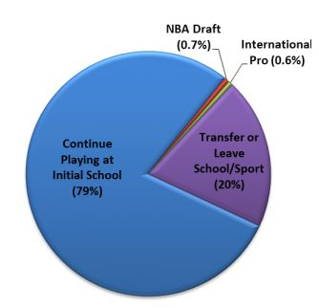
2014 Destination for 2013 Freshman MBB Student-Athletes
Destination | N | %
Other Div. I school | 53 | 24%
Division II | 30 | 14%
Division III | 3 | 1%
NJCAA / NAIA | 82 | 37%
Did not play | 41 | 18%
NBA Draft | 7 | 3%
International Pro | 6 | 3%

Slide 34
One-and-Done vs. Transfer
One-and-done: 8 NBA draftees on average each year since 2006 (although 14 likely this year).
Among the last 32 one-and-done SAs in MBB, 30 earned their spring term APR eligibility point. Average college GPA = 2.88.
Bigger issue = transfer. 21% depart after one year, 40% after two years. Many transfer out of Division I.
Transfer SAs: Less likely to graduate and longer time to graduate, loss of credits, higher ineligibility.

Slide 35
Graduate transfers within Division I typically earn their master’s degrees

Slide 36
Grad Transfer Completion Status by Sport
Note: Completion status for 2011-12 and 2012-13 cohorts of graduate transfers after their fourth semester or later (Summer 2014).

Slide 37
You can’t believe the NCAA’s graduation rates– their numbers are distorted.

Slide 38
NCAA Graduation Rates
Federal Graduation Rate: Federally mandated calculation for all schools that offer athletic scholarships. Counts all transfers as academic failures, so essentially measures the percentage of students who complete a BA/BS from their initial school within six years.
Graduation Success Rate (GSR): Division I rate that accounts for transfers in/out. Also tracks graduation over six years.

Slide 39
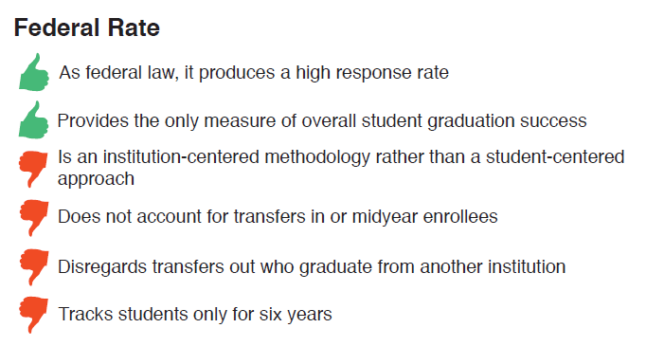
Federal Graduation Rate: Thumbs Up or Thumbs Down?

Slide 40
Annual Graduation-Success Rates of All Student-Athletes at Division I Institutions Overall and by Race/Ethnicity
White 89% +8%
Overall 84% +10%
African-American 70% +14%

Slide 41
Comparison of Graduation-Success Rates from Entering Classes of 1995 and 2007
Student-Athlete Group | 1995 GSR | 2007 GSR
Overall | 74% | 84%
White Males | 76% | 85%
African-American Males | 51% | 65%
White Females | 89% | 93%
African-American Females | 71% | 81%
*1995 was the last year of the former initial-eligibility rules known as Prop. 48.
It was also the first year in which GSR data were collected.

Slide 42
Comparison of Federal Graduation Rates Between Division I Student-Athletes and Student Body For Select Groups in 2007 Entering Class
Student-Athlete Group | Student-Athlete Federal Rate | Student Body Federal Rate
Overall | 66% | 65%
White Males | 64% | 65%
African-American Males | 52% | 41%
White Females | 76% | 70%
African-American Females | 63% | 50%

Slide 43
APR data show that academic challenges are similar across all sports and schools

Slide 44
APR Summary
APRs continue to rise across all sports and all segments of Division I.
APR improvements are expected to translate into additional gains in graduation rates over the next couple years.
Football still struggles with degree progress. Issues in men’s basketball relate more to high rates of transfer than to problems with degree progress.
The vast majority of current APR difficulties are occurring at the lowest-resourced institutions.

Slide 45
APR Trends in Baseball, Basketball and Football
Notes:
Analyses based on 271 baseball squads, 323 men’s basketball squads, 228 football squads, and 321 women’s basketball squads that sponsored the sport within Division I and provided usable data during all 11 years.
APR retention calculation changed beginning in 2007-08 to grant point adjustments for certain transfer students (timing of calculation change = Year 5 on graph). Change did not affect eligibility rate calculation.

Slide 46
Eligibility Trends in Baseball, Basketball and Football
Notes:
Analyses based on 271 baseball squads, 323 men’s basketball squads, 228 football squads, and 321 women’s basketball squads that sponsored the sport within Division I and provided usable data during all 11 years.
APR retention calculation changed beginning in 2007-08 to grant point adjustments for certain transfer students (timing of calculation change = Year 5 on graph). Change did not affect eligibility rate calculation.

Slide 47
Retention Trends in Baseball, Basketball and Football
Notes:
Analyses based on 271 baseball squads, 323 men’s basketball squads, 228 football squads, and 321 women’s basketball squads that sponsored the sport within Division I and provided usable data during all 11 years.
APR retention calculation changed beginning in 2007-08 to grant point adjustments for certain transfer students (timing of calculation change = Year 5 on graph). Change did not affect eligibility rate calculation.

Slide 48
Schools should get APR credit for any transfer who leaves eligible

Slide 49
What are APR Point Adjustments?
Under certain conditions, the NCAA may excuse a lost APR eligibility or retention point in a team’s APR calculation.
There are several circumstances under which teams may be eligible to receive adjustments to lost eligibility or retention points in the APR calculation:
Student-athlete or family member illness / personal difficulties, natural disaster, family hardship, degree program or sport discontinued, opportunity to compete in Olympics or other international competition (eligibility and/or retention point loss adjusted).
Student-athlete leaves school while academically eligible to pursue a professional sports opportunity (retention point loss adjusted).
Student-athlete leaves school while academically eligible with a GPA of 2.6 or higher (and other academic factors met) and transfers immediately as a full-time student to another four-year college (retention point loss adjusted).

Slide 50
Why a 2.60 GPA for the Transfer Adjustment?
Longitudinal research has shown that student-athletes who transfer with a 2.60 GPA have a similar probability of graduation as do non-transfers with a 2.00.
Research indicates that both eligibility (E) and retention (R) are important components of APR to optimally predict graduation rates. Giving a transfer adjustment for R when GPA < 2.60 lessens the APR-GSR correlation.
A more nuanced assessment of a student-athlete’s transferrable credits might be preferred to the 2.60 GPA standard. However, no support exists currently for such an administrative change within the Academic Performance Program.

Slide 51
NCAA research on academics is difficult to find

Slide 52
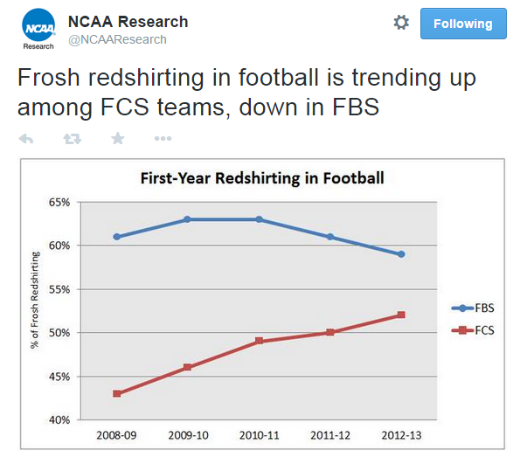
@NCAAResearch on Twitter

Slide 53
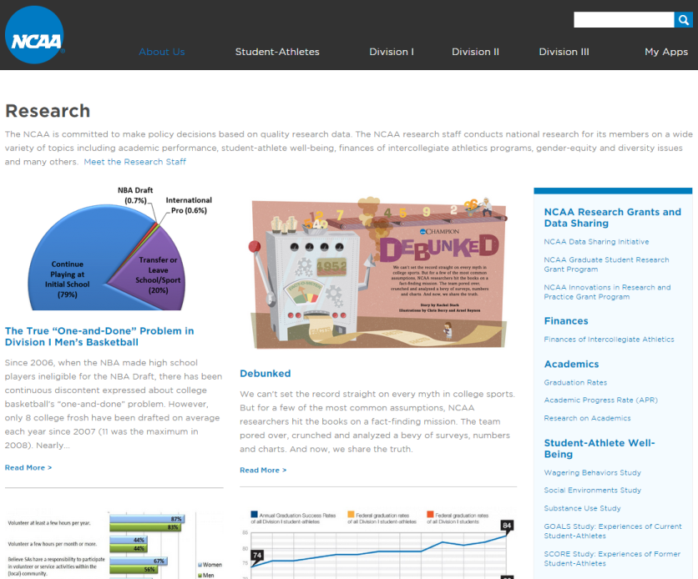

Slide 54
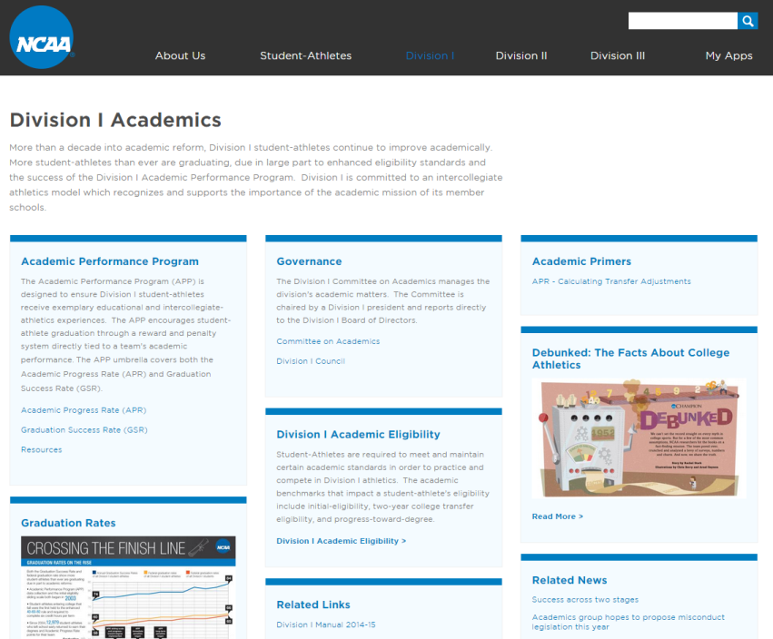

Slide 55
Contact
NCAA Research -- www.ncaa.org/research
Follow us on Twitter – @NCAAResearch

